Slide 1
7-2 USING AN vs. A
(b) I have an idea.
(c) I have an old horse.
words that begin
with vowels
an

Slide 2
7-2 USING AN vs. A
(d) I have an ugly dog.
(e) I have a useful idea.
/uh/ vowel sound
/yu/ sound

Slide 3
7-2 USING AN vs. A
(f) Give me an honest answer.
(g) Today is a hot day.
silent /h/, vowel sound
/h/ sound

Slide 4
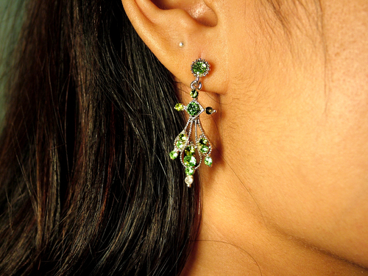
7-2 Let’s Practice
a an
an
She has ___earring.

Slide 5
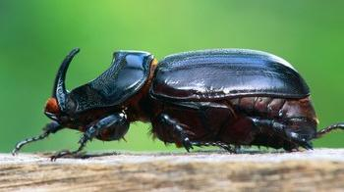
7-2 Let’s Practice
a an
That is ___ ugly bug.
an

Slide 6
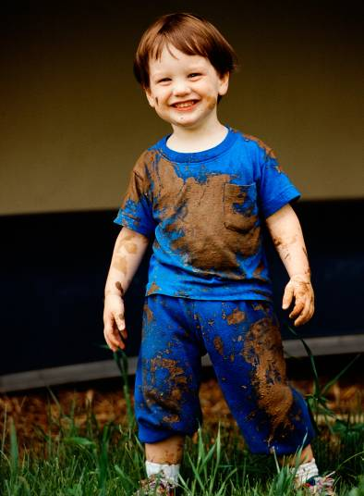
7-2 Let’s Practice
a an
He is __ happy child.
a

Slide 7
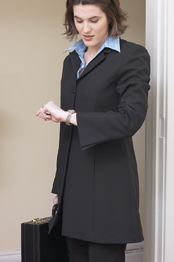
7-2 Let’s Practice
a an
Let’s go in __ hour.
an

Slide 8
7-3 Let’s Practice
a an
That is _____ hat.
a

